Slide 1
conjunctions and punctuation

Slide 2

Coordinating Conjunctions
These words are placed in the middle of a sentence to join two independent clauses and should follow a comma.
Although the punctuation is often omitted in everyday writing, you should make an effort to use it because the comma serves to clearly separate the parts of the sentence and helps the reader follow your ideas more easily.

Slide 3
Correct: AI has enormous potential to improve people’s lives, but it also comes with some risks.
Avoid: AI has enormous potential to improve people’s lives but it also comes with some risks.
Note, however, that if a subject does not appear in the second clause, the comma is unnecessary.

Slide 4
Correct: AI has enormous potential to improve people’s lives but also comes with some risks.
Iffy: AI has enormous potential to improve people’s lives, but also comes with some risks.

Slide 5
In addition, you should not place a comma after a conjunction.
Incorrect: AI has enormous potential to improve people’s lives, but, it also comes with some risks.
Occasionally, and primarily in journalistic or informal writing, conjunctions may be used at the beginning of a sentence (following a period/full stop) for emphasis, but in formal writing, this use should typically be avoided.
Avoid: AI has enormous potential to improve people’s lives. But it comes with some risks.

Slide 6
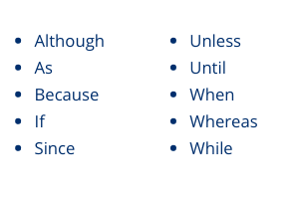
Subordinating Conjunctions
These conjunctions join dependent clauses (fragments) and independent. They can be placed either at the beginning of an entire sentence, or at the beginning of a clause in the middle of a sentence.

Slide 7
When the clause begun by a subordinating conjunction, a comma must be placed before the independent clause.
Correct: Although gene-editing technologies have enormous potential to improve people’s lives, they come with many serious risks.
Incorrect: Although gene-editing technologies have enormous potential to improve people’s lives they come with many serious risks.
If the independent clause comes first, a comma is typically used before certain “strong” conjunctions, e.g., (al)though, whereas, and while (as a synonym for whereas).

Slide 8
If a sentence is long and complex, it may make sense to place a comma before another conjunction, e.g. since or unless. If a sentence is short and straightforward, however, the comma is unnecessary.
Correct: Gene-editing technologies have enormous potential to improve people’s lives, although they come with many serious risks.
Correct: Gene-editing technologies come with many serious risks because they allow scientists to manipulate the fundamental building blocks of life.
Avoid: Gene-editing technologies come with many serious risks, because they allow scientists to manipulate the fundamental building blocks of life.

Slide 9
Remember that single clause begun by a subordinating conjunction is always dependent — it cannot stand on its own as a complete sentence and should not follow a period/full stop.
In addition, you should not place a comma after a subordinating conjunction.
Incorrect: Gene-editing technologies have enormous potential to improve people’s lives. Although, they come with many serious risks.

Slide 10
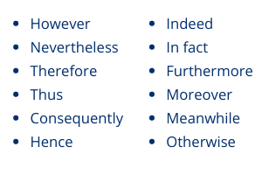
Conjunctive Adverbs
When conjunctive adverbs are placed at the beginning of a clause or sentence, they must follow a period (full stop) or semicolon. Although they are followed by a comma, they cannot follow a comma.

Slide 11
Correct: Gene-editing technologies have enormous potential to improve people’s lives. However, they come with many serious risks.
Correct: Gene-editing technologies have enormous potential to improve people’s lives; however, they come with many serious risks.
Incorrect: Gene-editing technologies have enormous potential to improve people’s lives, however, they come with many serious risks.

Slide 12
Example with thus:
Correct: AI comes with some risks. Thus, it must be carefully regulated.
Correct: AI comes with some risks; thus, it must be carefully regulated.
Incorrect: AI comes with some risks, thus, it must be carefully regulated.

